Slide 1


On the density distribution of bound clusters after residual star-forming gas expulsion: Zhao profiles
Olga Borodina, E. Polyachenko,
P. Berczik, M. Sobolenko, M. Ishchenko, B. Shukirgaliyev, A. Just
07.09.2021 Volkswagen Trilateral Project Workshop

Slide 2
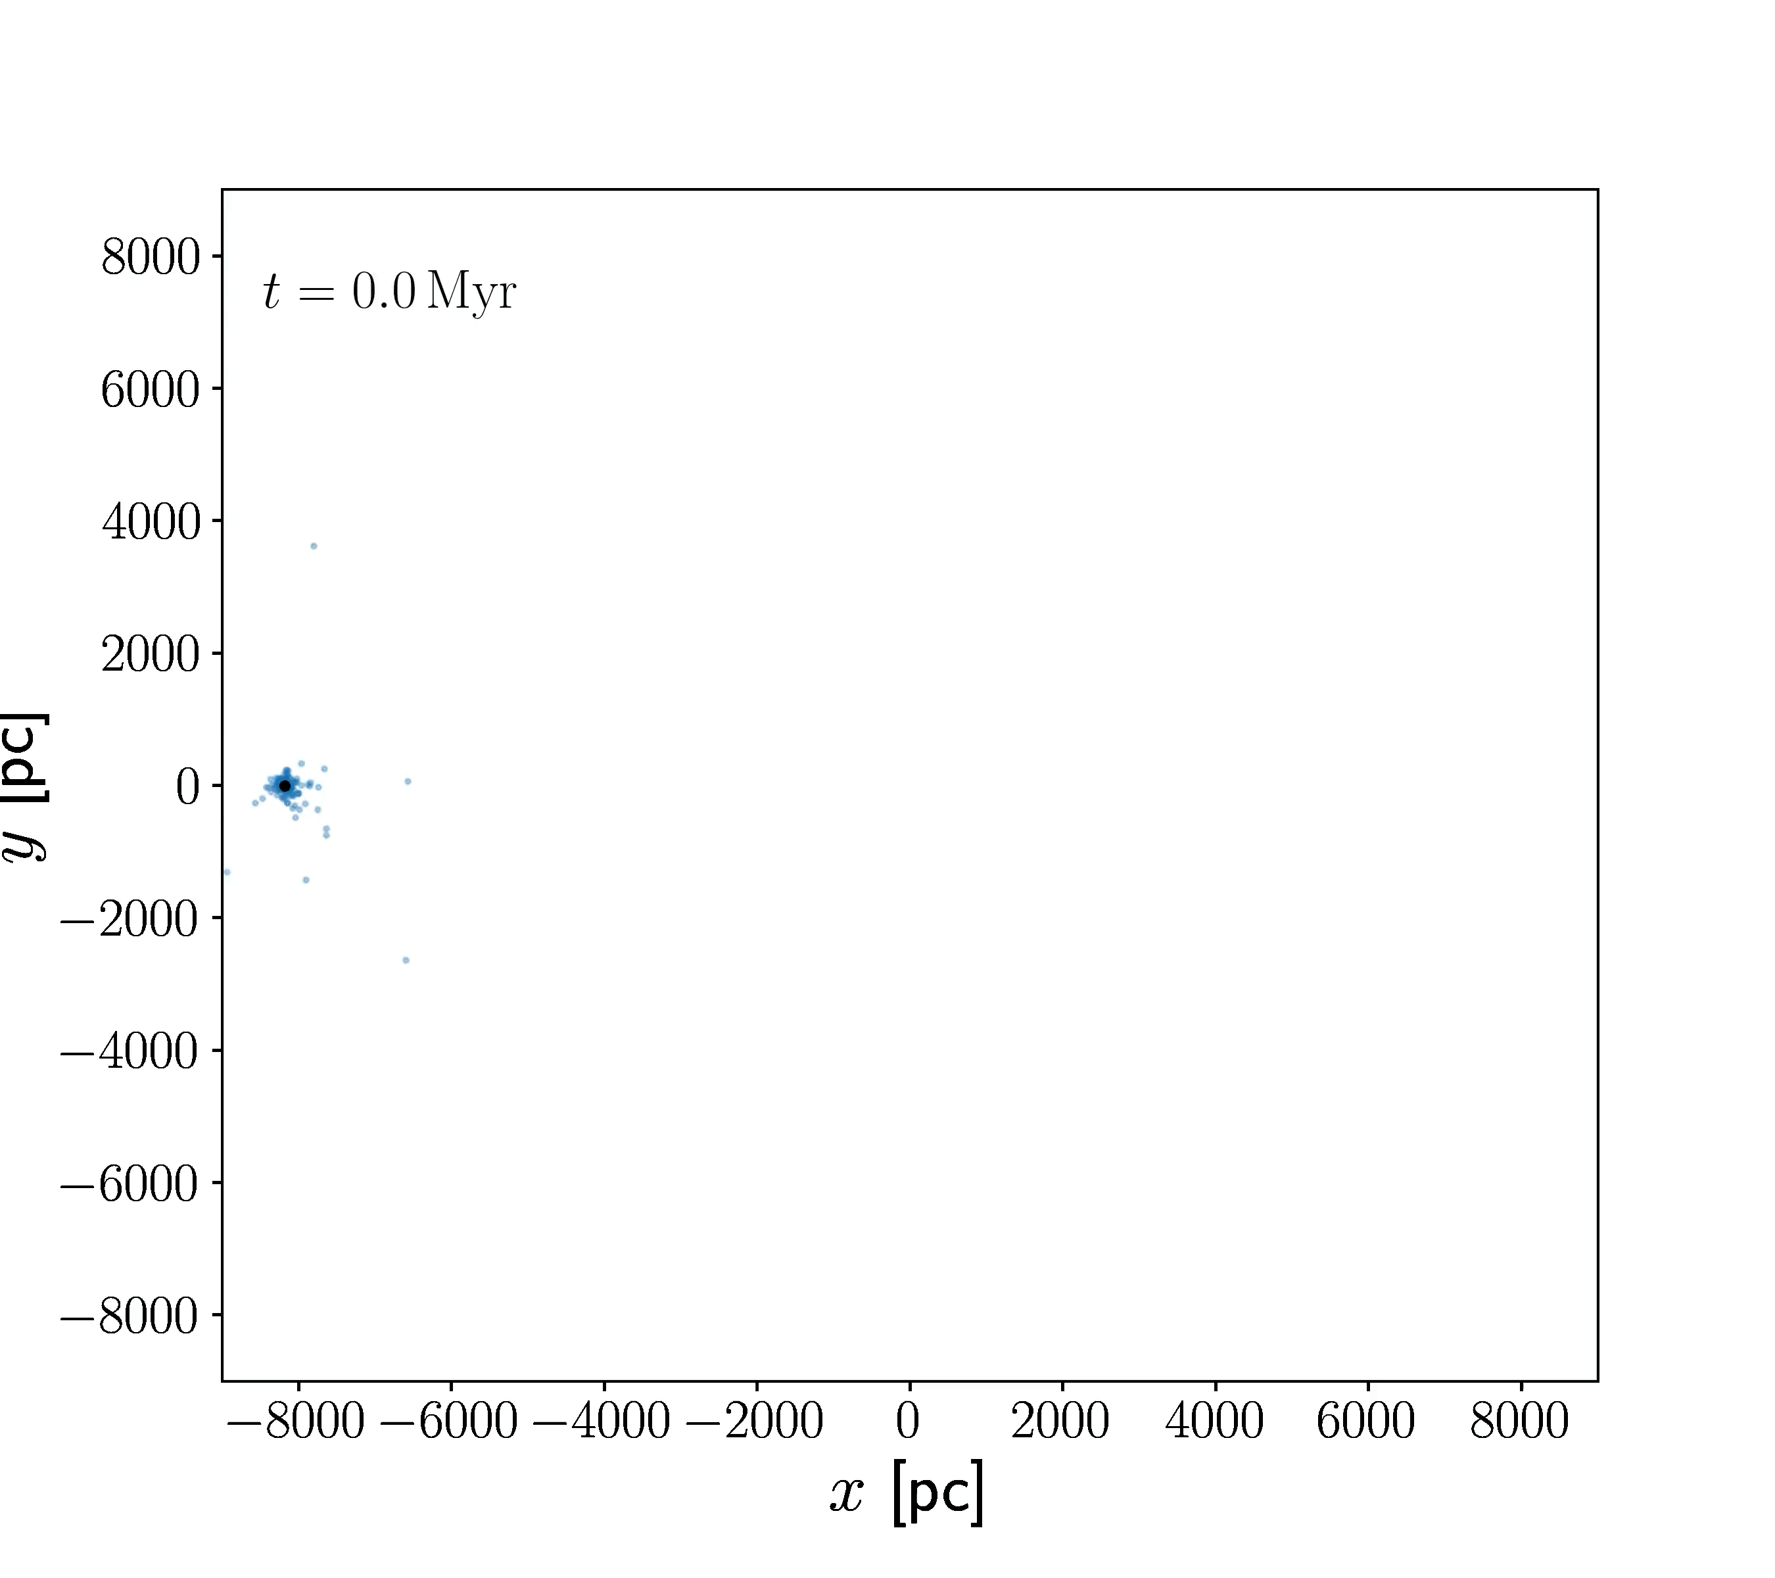
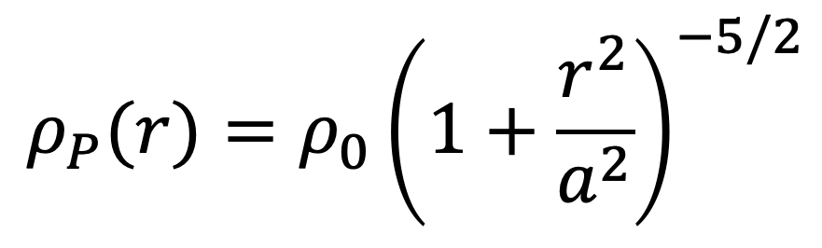
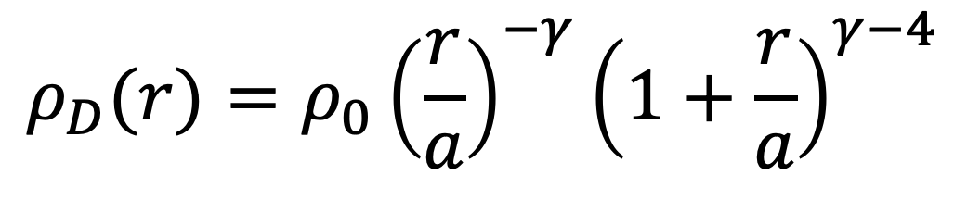
N-body simulations
Our model:
After gas expulsion
Dehnen and Plummer profiles
Shukirgaliyev et al., 2021; Shukirgaliyev et al., 2017
$$ρ_{D}(r)=ρ_{0}{\left(\frac{r}{a}\right)}^{−γ}{\left(1+\frac{r}{a}\right)}^{γ−4}$$
$$ρ_{P}(r)=ρ_{0}{\left(1+\frac{r^{2}}{a^{2}}\right)}^{−5/2}$$

Slide 3
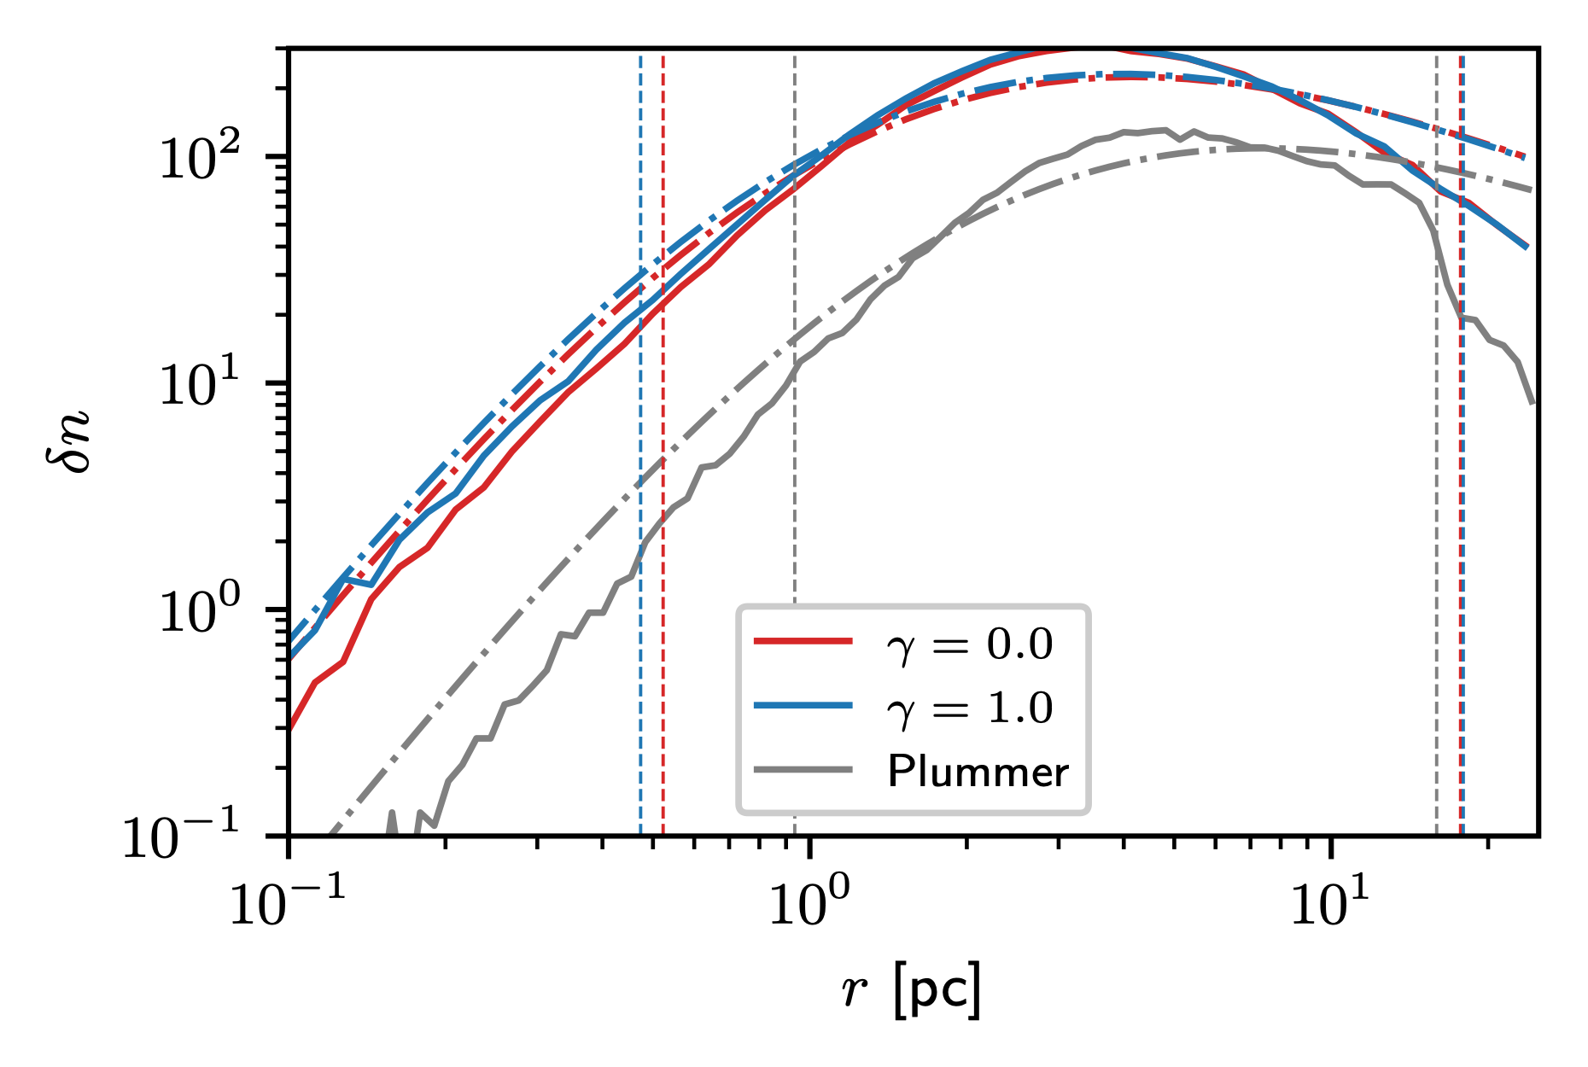
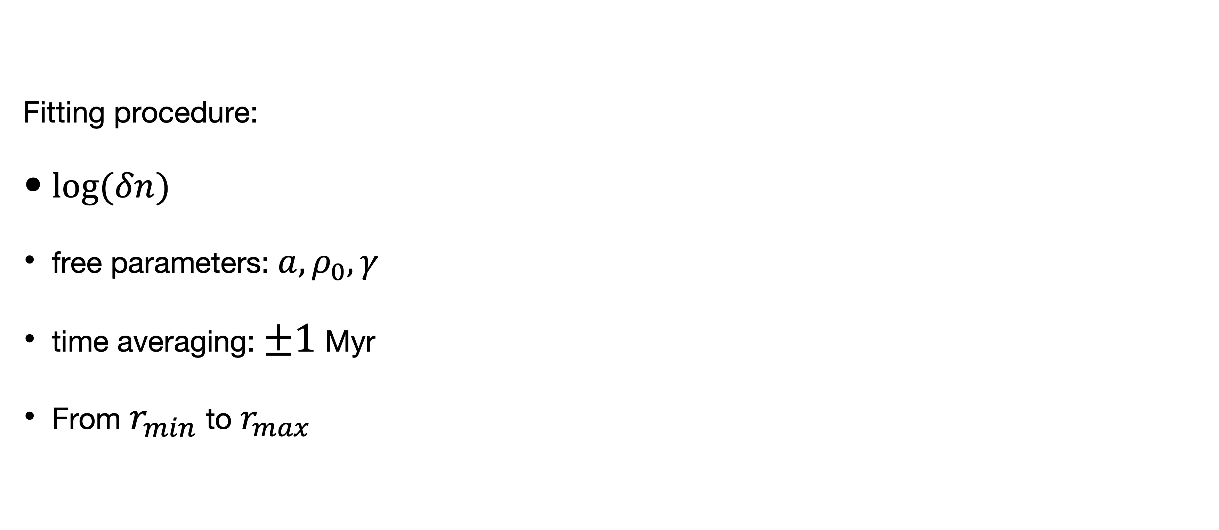
Fitting with Dehnen profile
Fitting procedure:
$log(δn)$
free parameters: $a,ρ_{0},γ$
time averaging: $±1$ Myr
From $r_{min}$ to $r_{max}$
t = 100 Myr,
SFE = 0.10 for Dehnen and
SFE = 0.20 for Plummer models

Slide 4
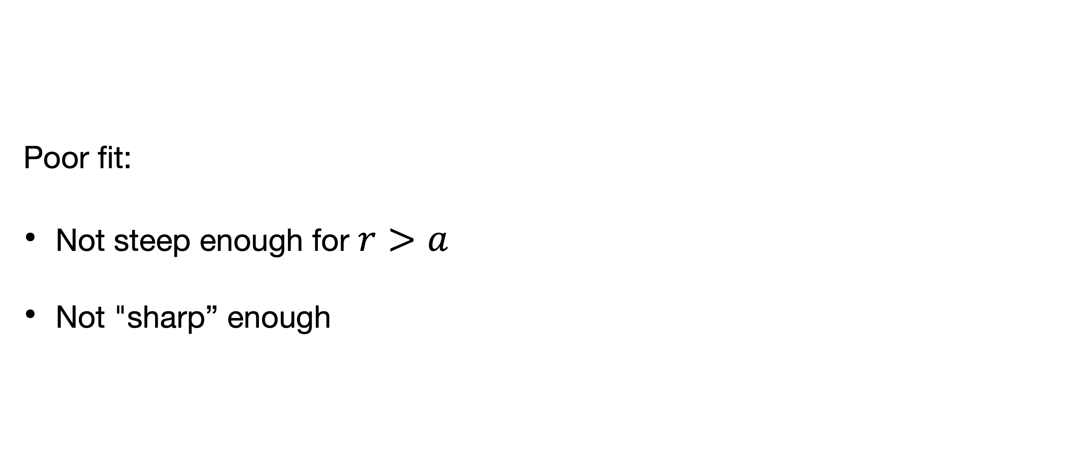
Fitting with Dehnen profile
Poor fit:
Not steep enough for $r>a$
Not "sharp” enough
t = 100 Myr,
SFE = 0.10 for Dehnen and
SFE = 0.20 for Plummer models

Slide 5
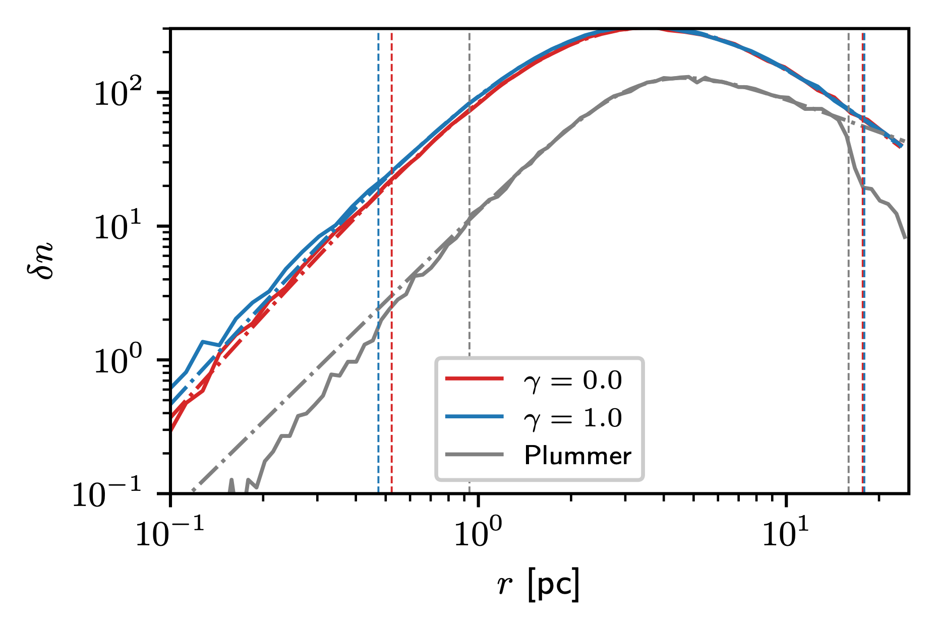
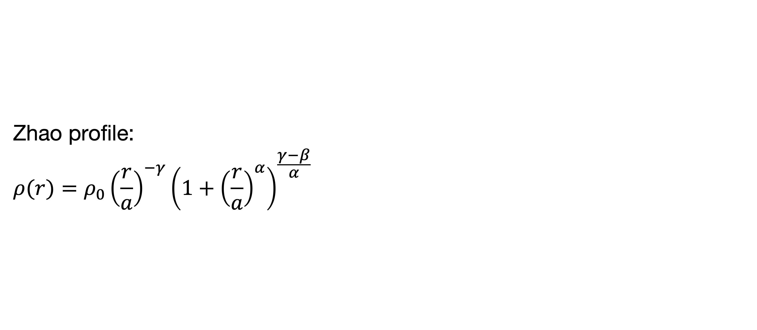
Fitting with Zhao profile
Zhao profile:
$$ρ(r)=ρ_{0}{\left(\frac{r}{a}\right)}^{−γ}{\left(1+{\left(\frac{r}{a}\right)}^{α}\right)}^{\frac{γ−β}{α}}$$
t = 100 Myr,
SFE = 0.10 for Dehnen and
SFE = 0.20 for Plummer models

Slide 6
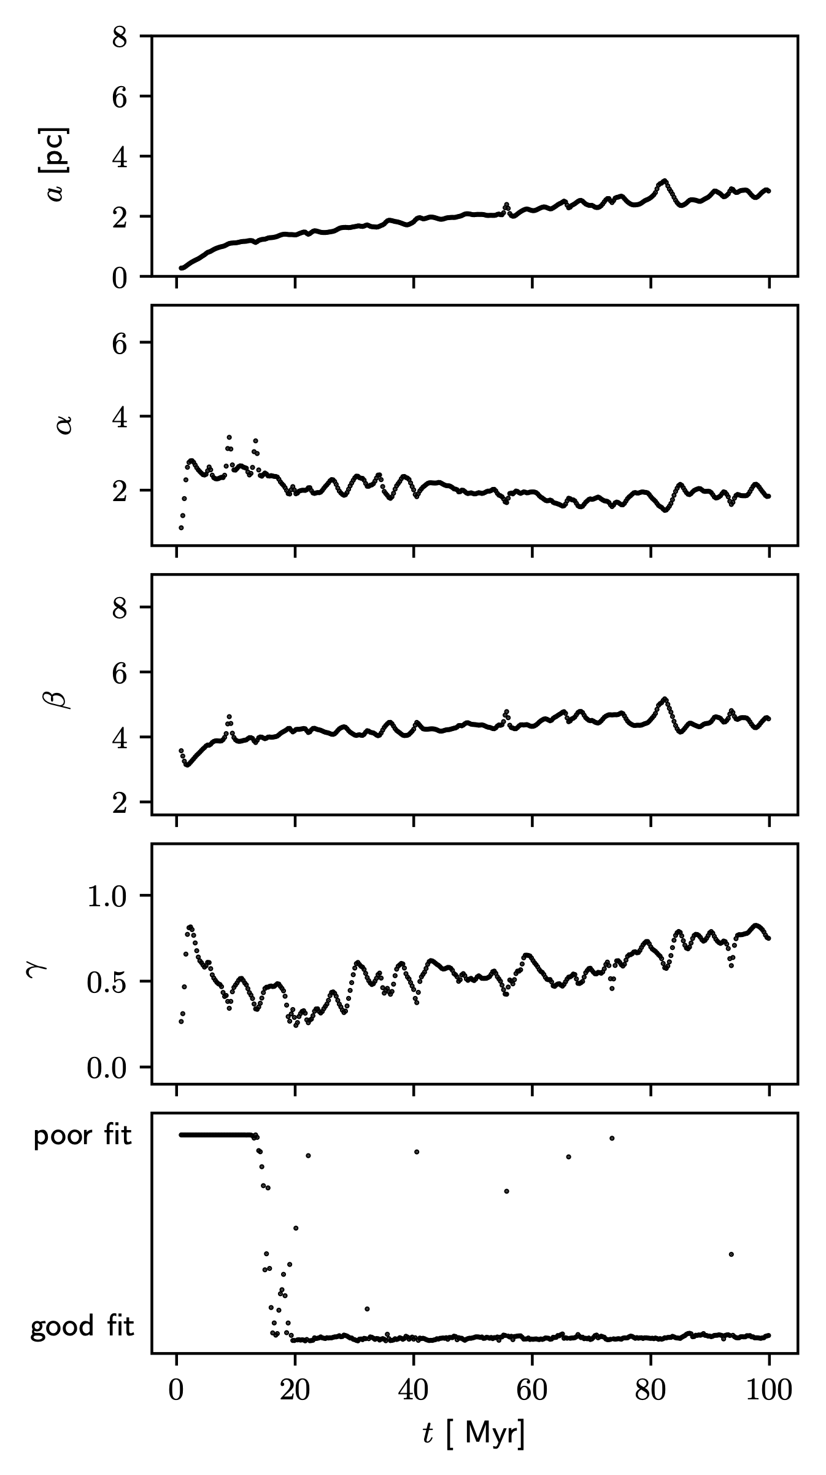
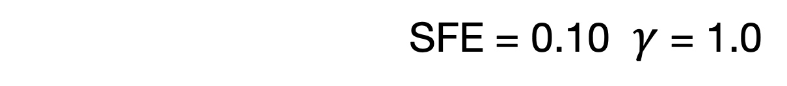
Parameters’ evolution
SFE = 0.10 $γ$ = 1.0

Slide 7
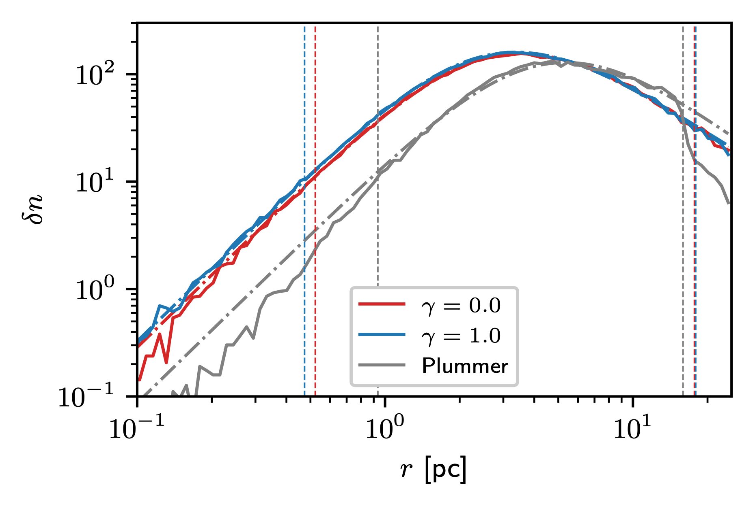
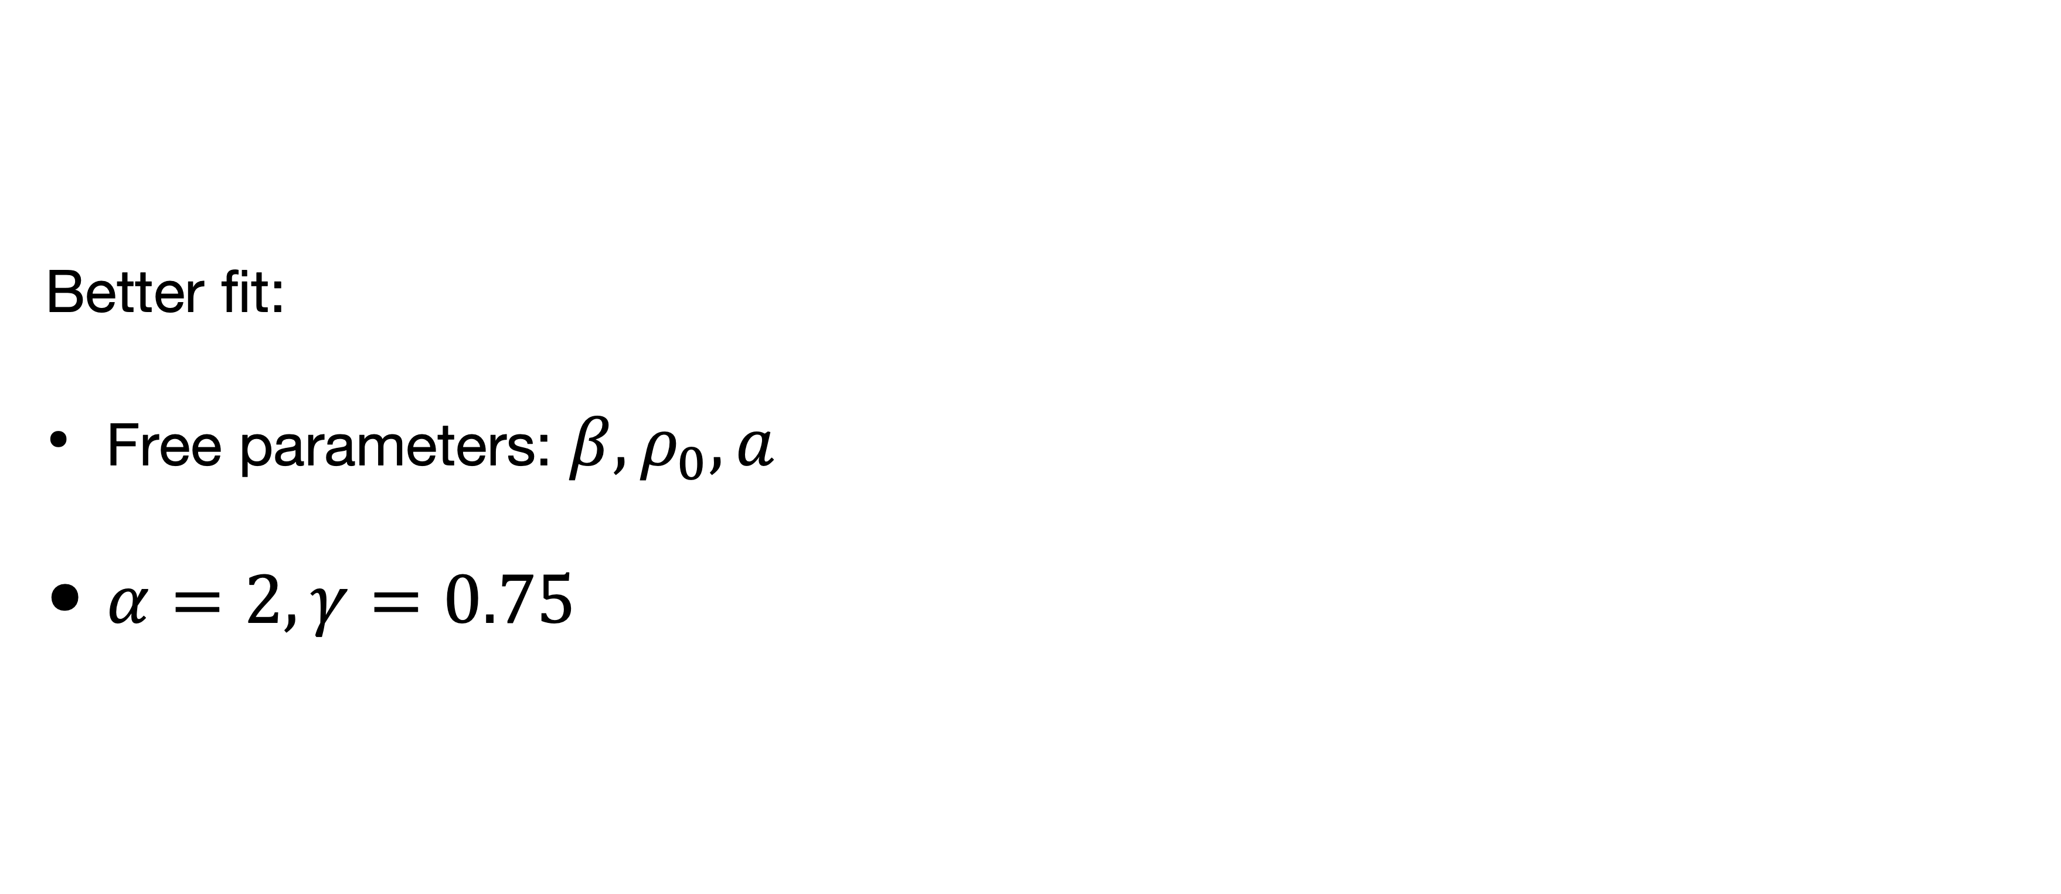
Fitting Zhao with fixed parameters
Better fit:
Free parameters: $β,ρ_{0},a$
$α=2,γ=0.75$
t = 100 Myr,
SFE = 0.10 for Dehnen and
SFE = 0.20 for Plummer models

Slide 8
Parameters’ evolution
SFE = 0.10 $γ$ = 1.0

Slide 9
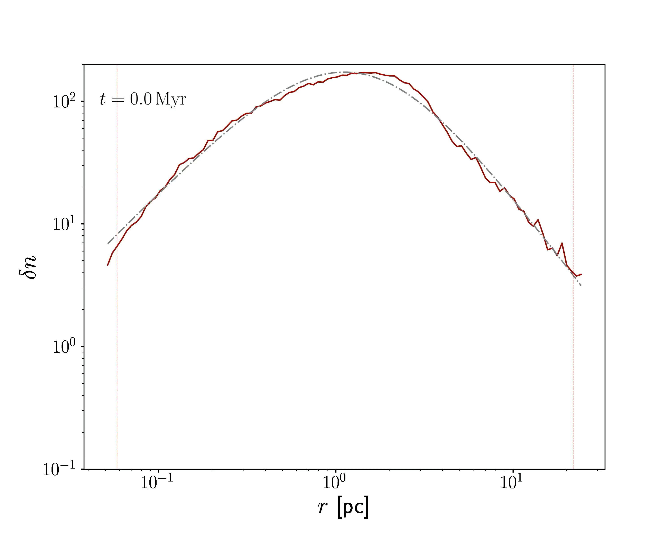
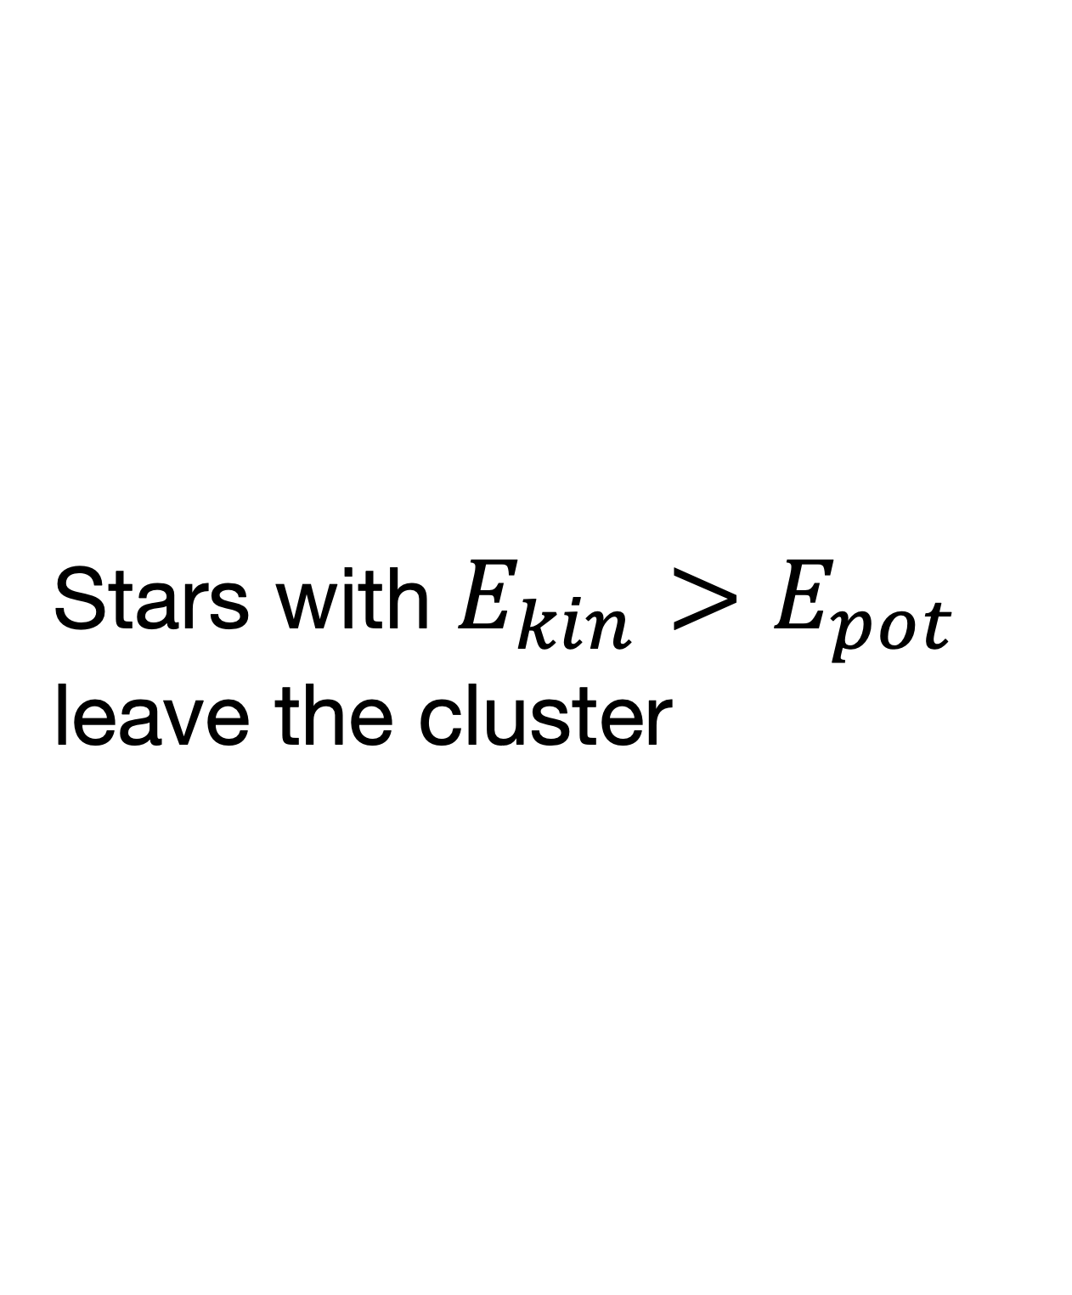
During the relaxation
Stars with $E_{kin}>E_{pot}$ leave the cluster

Slide 10
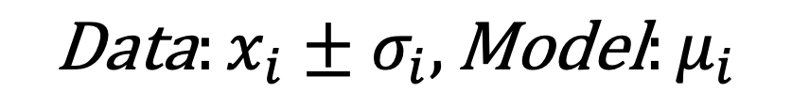
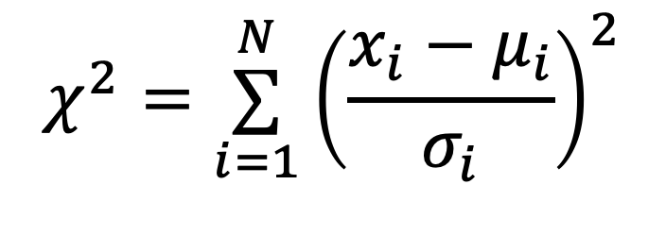
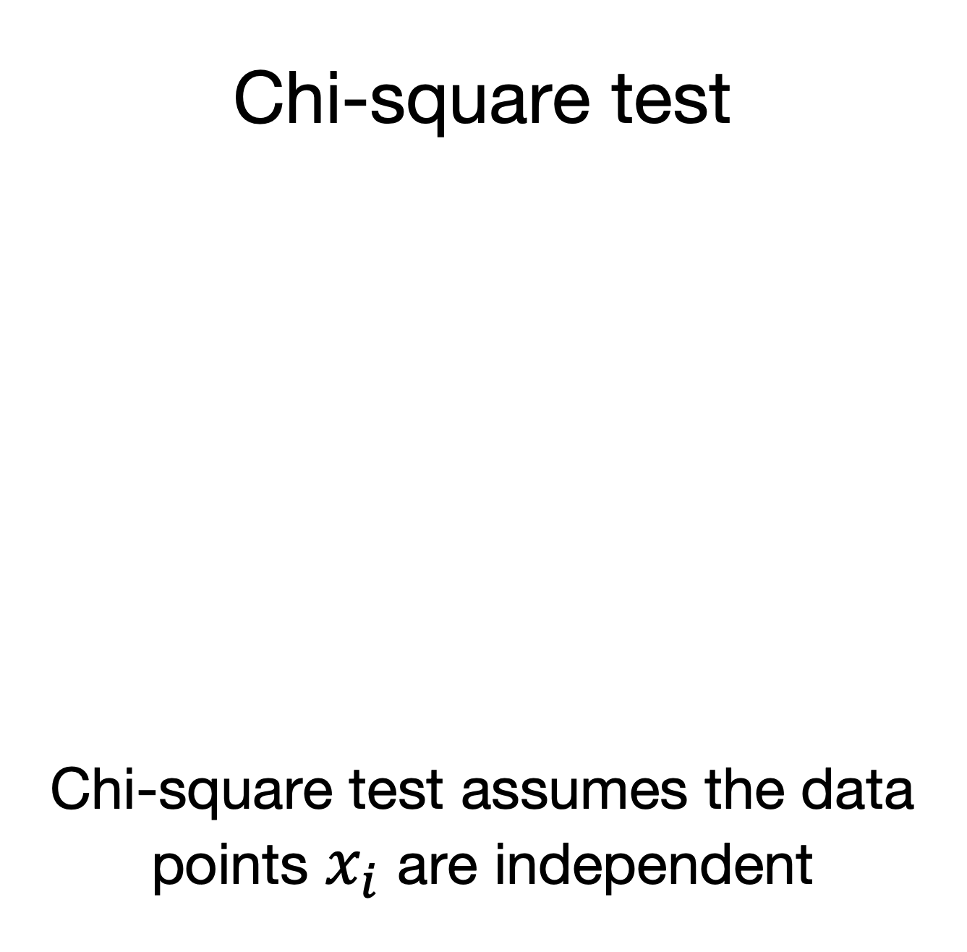
Goodness of fit estimation
Families of tests
Chi-square test
Chi-square test assumes the data points $x_{i}$ are independent
Kolmogorov-Smirnov test
$$χ^{2}=\overset{N}{\underset{i=1}{∑}}{\left(\frac{x_{i}−μ_{i}}{σ_{i}}\right)}^{2}$$
$$\text{Data}:x_{i}±σ_{i},\text{Model}:μ_{i}$$

Slide 11
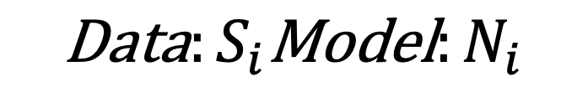
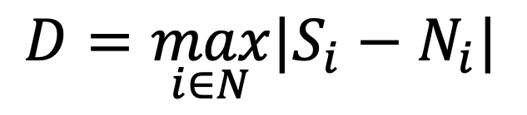
Goodness of fit estimation
Families of tests
Chi-square test
Chi-square test assumes the data points $x_{i}$ are independent
Kolmogorov-Smirnov test
KS test probabilities are wrong if the model was derived from the dataset.
$$χ^{2}=\overset{N}{\underset{i=1}{∑}}{\left(\frac{x_{i}−μ_{i}}{σ_{i}}\right)}^{2}$$
$$D=\max_{i∈N}|S_{i}−N_{i}|$$
$$\text{Data}:x_{i}±σ_{i},\text{Model}:μ_{i}$$
$$\text{Data}:S_{i}\text{Model}:N_{i}$$

Slide 12
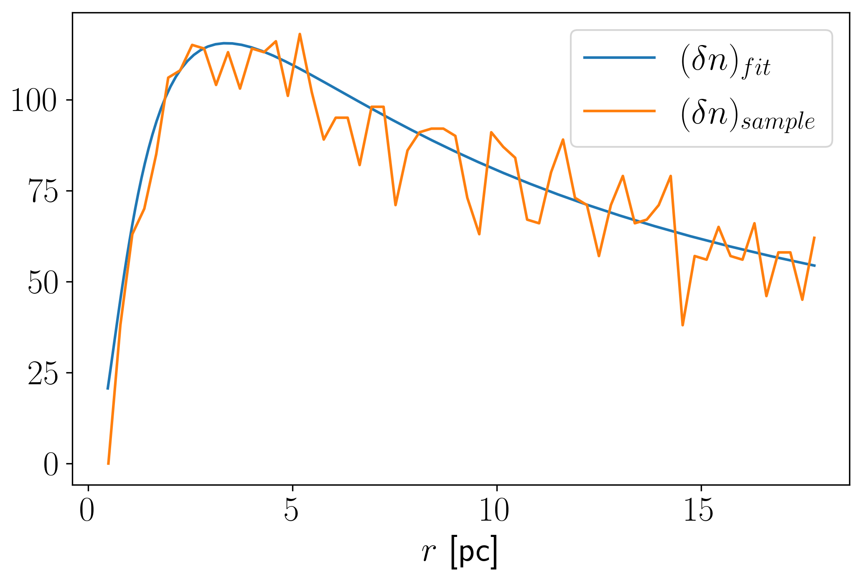
Bootstrapped K-S Test
First part: sampling
Cumulative
distributions
K-S statistics
calculation
G. Jogesh Babu & Eric D. Feigelson, 2006

Slide 13
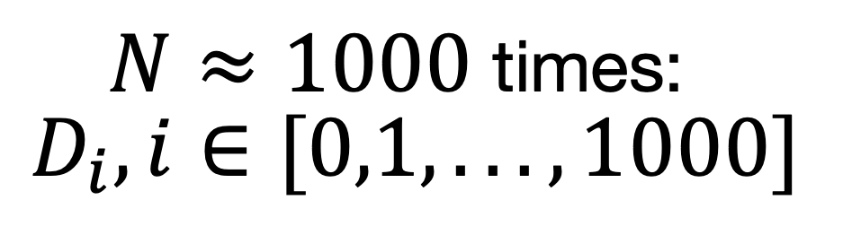
Bootstrapped K-S Test
First part: sampling
Cumulative
distributions
K-S statistics
calculation
$N≈1000$ times:
$D_{i},i∈[0,1,...,1000]$
G. Jogesh Babu & Eric D. Feigelson, 2006

Slide 14
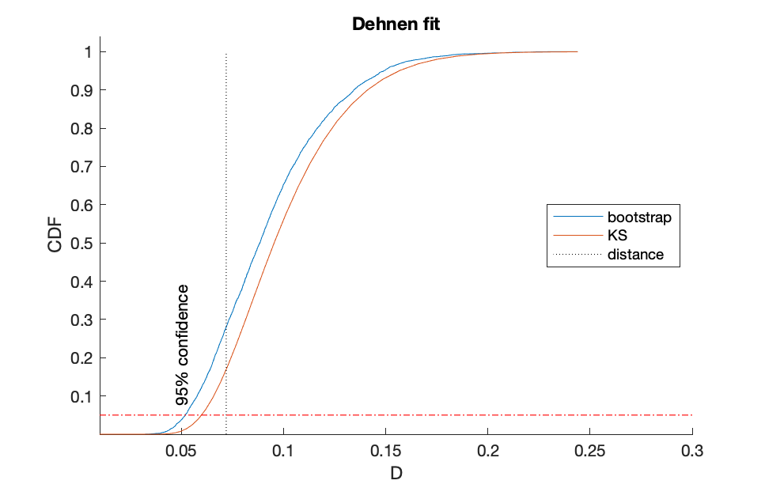
Bootstrapped K-S Test
Second part: evaluation
Cumulative
distributions

Slide 15
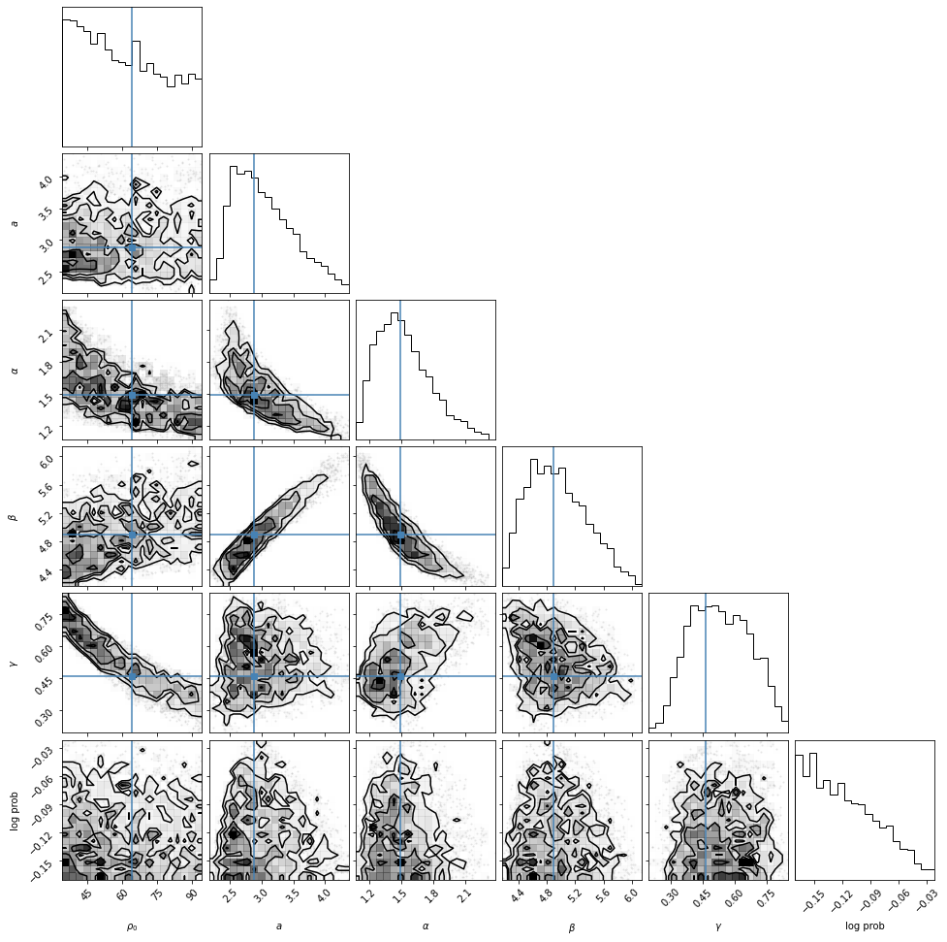
Future plans
Estimate goodness-of-fit for all models
Decrease the number of parameters
Apply chosen model to the observational data

Slide 18
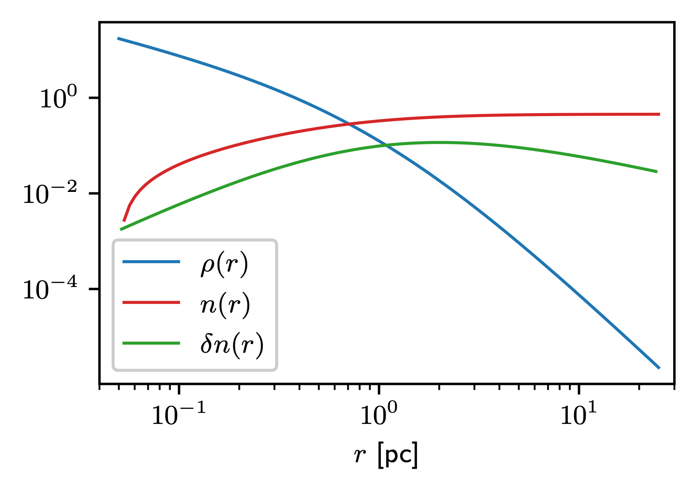
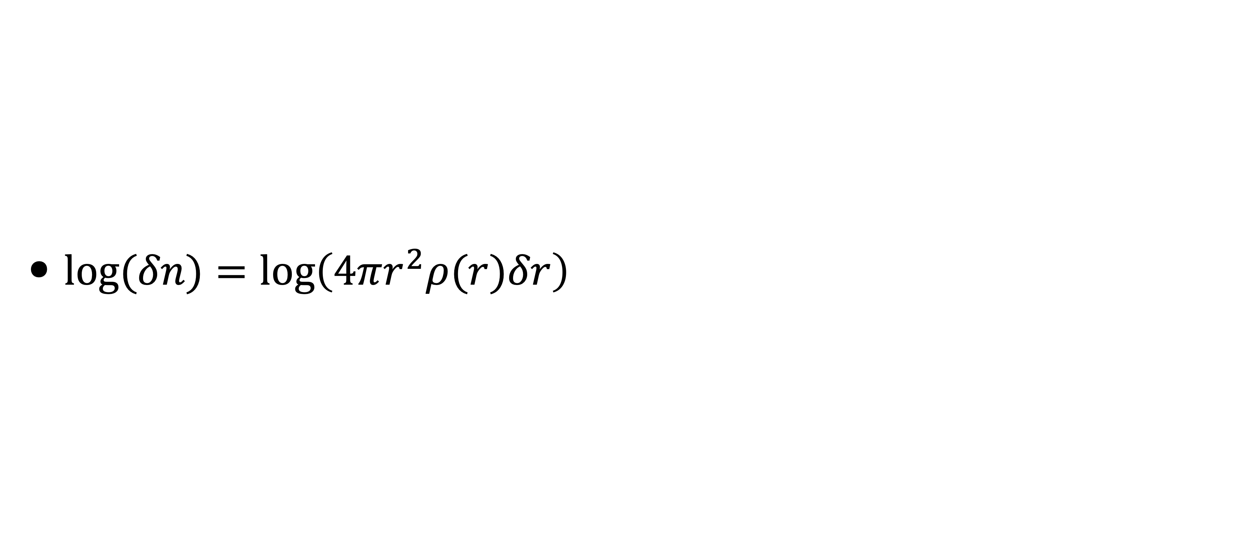
Different types of distributions
$log(δn)=log\left(4πr^{2}ρ(r)δr\right)$

Slide 19
